Slide 1
ANALYSIS ON FLOOD IN AFRIC.A
Table of Contents
Introduction
Data cleaning and manipulation
Data Analysis
Conclusions

Slide 2
INTRODUCTION
This is a descriptive analysis on flood in Africa to understand the impact and magnitude of flood across various regions in Africa.
About the Dataset:
eM-DAT Contains Data On The Occurrence And Impacts Of Over 26,000 Mass Disasters Worldwide From 1900 To The Present Day. The Database Is Compiled From Various Sources, Including UN Agencies, Non-governmental Organizations, Reinsurance Companies, Research Institutes, And Press Agencies. The Dataset Used For This Project Was Downloaded And Fitted For flood In Africa, And Consists Of 46 Columns . A Documentation Of The Data And Glossary Of Their Colums Can Be Found Onem-dat Website

Slide 3
Research questions
Which country were hit the most
the country with most people affected
Which year has the highest hit
Top 10 countries by no. of homless
The countries with the highest death
Top 10 countries by no injured

Slide 4
Data cleaning and manipulation
This data was cleaning using the following process;
Reading the excel file
Checking for duplicates
Checking for null values
Dropping of columns
Filling some columns with data
Checking /changing of data typr
Exporting cleaned data as csv file
Beolw tools were used for data cleaning and analysis
Numpy
Pandas
Matplotlib.pyplot
Plotly.express

Slide 5
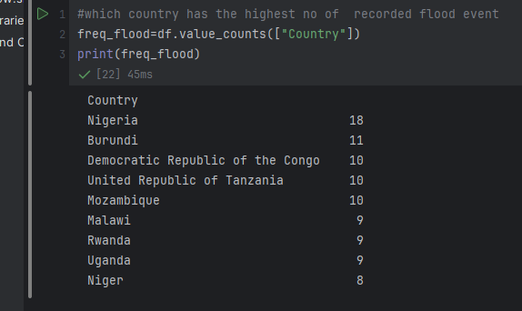
Which country were hit the most
From the data, Nigeria is the country with the highest hit in Africa. It has a record of 18 reoccurred times across the region more than any other country.

Slide 6
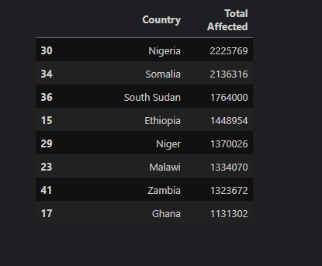
Country with most people affected.
Nigeria Is The Country With The The Most No Of People Affected With 2225769 People Affected Over The Period Of Time

Slide 7
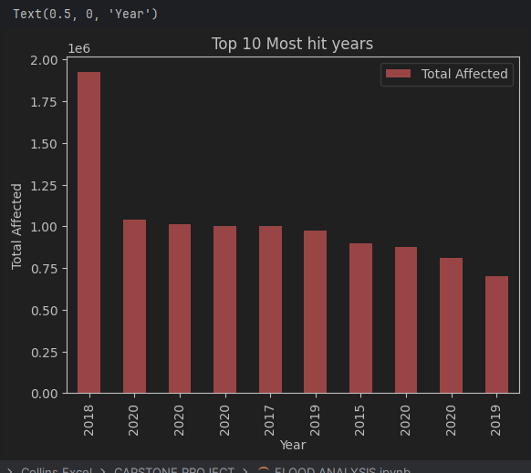
Which year has the highest hit
From the chart, 2018 stands to be the year with the highest hit with over 2,000,000 persons affected in a single year .

Slide 8
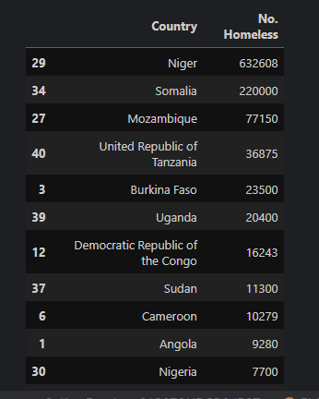
Top 10 countries by no. of homless
Despite Nigeria having the highest number of affected persons, Niger is the country with the highest number of deaths recored as a result of flood.

Slide 9
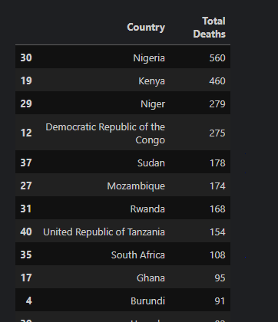
Top 10 countries by total death
This Chart Show The Countries With The Highest Number Of death recoreded. It Is Arranged In Descending Order With NIgeria Toping The List And Ghana In The Last Position Of The Chart.

Slide 10
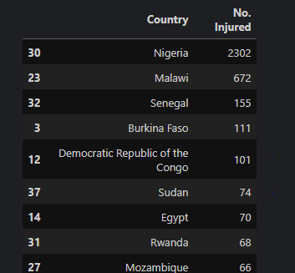
Top 10 countries by no injured
Nigeria stiil tops the list of total injured persons across Africa with the sum of 20302 injured persons

Slide 11
CONCLUSION
Floods in Africa are recurring disasters, often caused by heavy rainfall, overflowing rivers, and climate change. They impact millions, causing displacement, damage to infrastructure, and loss of life. Countries like Nigeria, Mozambique, and South Sudan are frequently affected.

